Slide 1
PPT模板下载：www.1ppt.com/moban/ 行业PPT模板：www.1ppt.com/hangye/
节日PPT模板：www.1ppt.com/jieri/ PPT素材下载：www.1ppt.com/sucai/
PPT背景图片：www.1ppt.com/beijing/ PPT图表下载：www.1ppt.com/tubiao/
优秀PPT下载：www.1ppt.com/xiazai/ PPT教程： www.1ppt.com/powerpoint/
Word教程： www.1ppt.com/word/ Excel教程：www.1ppt.com/excel/
资料下载：www.1ppt.com/ziliao/ PPT课件下载：www.1ppt.com/kejian/
范文下载：www.1ppt.com/fanwen/ 试卷下载：www.1ppt.com/shiti/
教案下载：www.1ppt.com/jiaoan/ PPT论坛：www.1ppt.cn
Development and Evaluation of Mixed Reality Educational Applications
DUAN XIAOYUN
2018.05.29
Game Multimedia Engineering, PaiChai University

Slide 2
Development and Evaluation of Mixed Reality Educational Applications
Duan xiaoyun

Slide 3
INTRODUCTION

Slide 4
Introduction
This thesis introduces the core technology and application situation of Virtual Reality and Augmented Reality in education and designs and develops three education applications
VR Art Exhibition
AR 3D Coloring Game
MR Chemistry Lab
Analyzes the education effects, user experience, equipment features, and implementation effects of these applications, expounds the advantages comparing with traditional teaching mode and the means to integrate Virtual Reality and Augmented Reality technologies with education teaching
Some referential experience and methods in AR and VR education applications derived in the thesis provide useful references for the improvement and enhancement of the application of Virtual Reality and Augmented Reality technologies in education teaching
Notes:
虚拟现实和增强现实技术如何更好地应用在教学之中，智能技术与传统教学方式如何优势互补，是教育研究者和一线教育实践工作者需要探索的问题。让学生可以从被动的接受过程转变为在自主体验的过程中进行学习。这将通过虚拟现实技术和增强现实技术推动

Slide 6
Concepts
Virtual Reality - Virtual Reality mainly refers to the three-dimensional VR based on head-mounted equipment
VR HMD + PC
VR HMD + Mobile
VR all in one
Augmented Reality - Augmented Reality overlays digital imagery onto the real world
Vision based AR
Marker-Based AR
Marker-Less AR
AR Kit and AR Core
LBS based AR

Slide 7
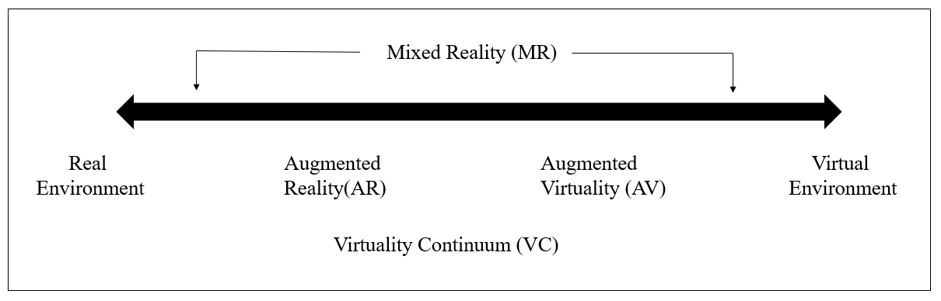
Mixed Reality
Paul Milgram and Fumio Kishino propose the reality-virtual reality continuum which respectively takes the real environment and virtual environment as the two ends of the continuum and defines the middle part as the “mixed reality

Slide 8
Distinguish of VR and AR
VR places users in the virtual world while AR places the virtual world before the eyes of users
VR creates a totally virtual world and separates users from the real world as shown in the left figure. The core problem is graphic calculation and immersive sense
AR technology supplements virtual objects to the top layer of graph in the real world to augment and expand the information in the real world as shown in the figure. The core problem is graphic identification and trajectory

Slide 9
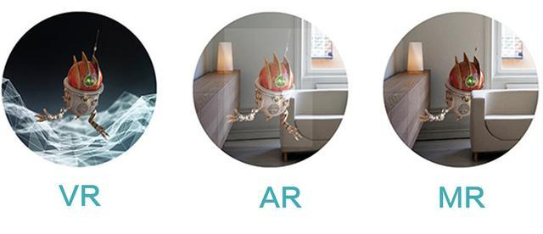

Slide 10
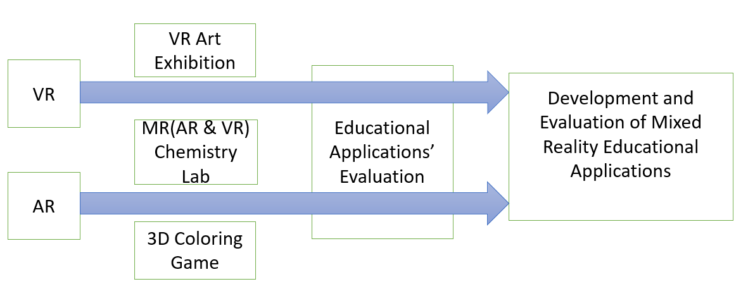
Research papers

Slide 11
Related Work
In spite of the short term of educational application of VR and AR technology, it coincides with the opinions of educational theories such as behaviorism and constructivism
In behaviorism theory, learning is stimulus-reaction connection constituted by the interrelation between knowledge and the outside world. The learning environment created by VR and AR could promote learners to seek feedback from the interaction with environment and retrieve subsequent action directives so that the connection between knowledge and reaction could be fully found
Considerable construction instrument systems and presentation areas provided by VR and AR virtual learning situation and learners’ subjective initiative coincide with Piaget’s conception and practice of “moving laboratory to the classroom” and the constructivism view of “learning is certain experience in real situation”

Slide 12
Educational Applications types
3D Virtual Learning Environment
Sloodle (Second Life Object-Oriented Distributed Learning Environment)
AR Books
The Magic Book produced by Damine Hirst , By producing the 3D scene and animation in accordance with book contents and utilizing a special pair of glasses to make children see the virtual-real scene
Science Teaching
Beijing Normal University explores the influence of AR technology on Grade Eight students’ physics learning effects and deep cognition in the empirical research
AR and VR Language Teaching
AR school” English ; Coqui ABC Immersive Children’s English Learning
VR Practical Training
Virtual Construction Site Program
Location Based AR Learning
Tourist attractions
Other applications
ChinAR

Slide 13

The Magic Book produced by Damine Hirst , By producing the 3D scene and animation in accordance with book contents and utilizing a special pair of glasses to make children see the virtual-real scene
I Dinosaur

Slide 14
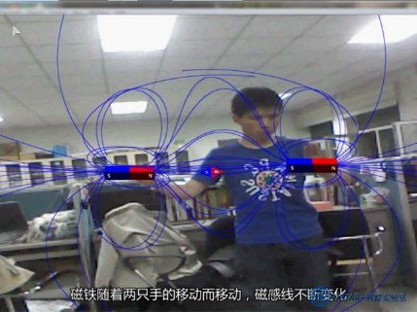
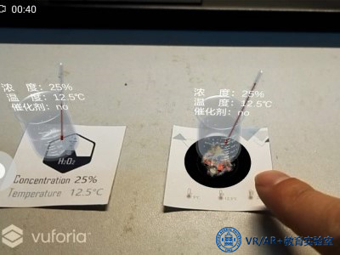
Cai Su et al realize the visualization of magnetic field by combining AR with Kinect somatosensory equipment. While learning the knowledge concerning magnetic field, students could have real-time interaction with equipment by means of gestures and therefore learn about the distribution and changes of magnetic field
Combining with PC or tablet teaching, AR technology could examine its influence on chemical reaction by controlling temperature, concentration, catalyst and other conditions in the means of natural interaction

Slide 15
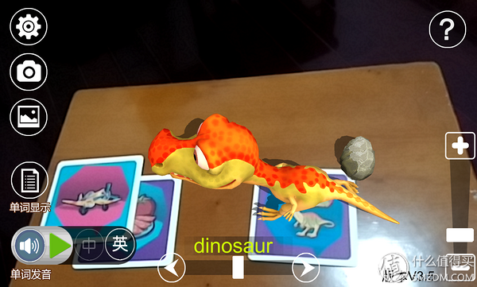
AR and VR Language Teaching
Scanning cards with tablet computers or phones to discern words, and present relevant pictures or 3D models with pronunciation could help children spell vocabulary and learn pronunciation
Notes:
轻松实现传统课堂无法实现的教学方式。一节课50分钟，前30分钟进行传统教学，老师会带着学生认识拼写单词，比如长颈鹿、老虎、狮子等，最后20分钟才会让学生使用VR头显设备进入虚拟世界互动，这样可以达到巩固学习的效果。 而家长也普遍认为这种教学很有效

Slide 16
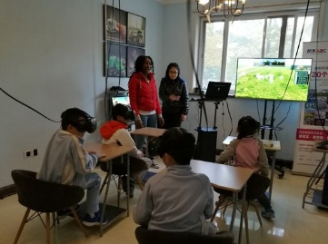
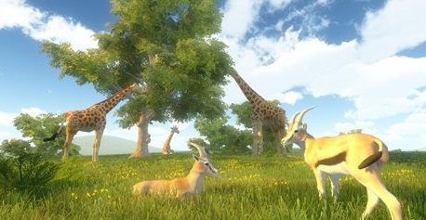
Coqui ABC Immersive Children’s English Learning
Teachers could fully develop the infinite potentials of virtual space and easily realize the teaching mode that could never be actualized in traditional class. In one class with 50 minutes, teachers usually make traditional teaching in former 30 minutes to lead students to spell vocabulary, such as giraffe, tiger and lion, and ask students to use VR head-mounted equipment to interact with the virtual world in the last 20 minutes. Such practice could consolidate the learning effects

Slide 17
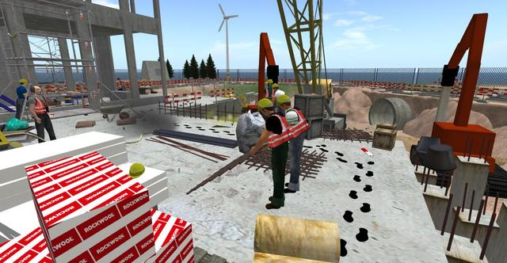
VR Practical Training
Virtual Construction Site Program
This site exist severe security problems. Whereas, students could move around in the virtual environment and take photos in safe places. Such case is nearly impossible in real life. Out of this reason, this is in particular suitable for the virtual world
Notes:
能够在不离开教室的情况下介绍某些特定场景的知识,学生们不再是听课，而是在头戴设备中跟着讲解，得到真实的体验——只不过在虚拟环境中.
虚拟教育专家英格•克努森（Inge Knudsen）搭建了一个虚拟建筑工地，这个工地上存在许多的安全问题，学生们可以在虚拟环境中来回走动，找到不安全的地方拍照记录。这样的案例在现实生活中觉不可能进行，因此尤其适合虚拟世界

Slide 18
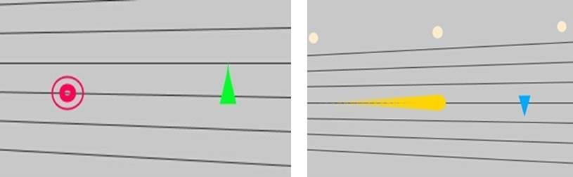
Chinese Zither Application
Chinese zither has its own set of musical systems and learners have to learn and adapt to many new concepts and methods in the introduction stage. At this point, its introduction threshold is obviously higher than that of other musical instruments
The application of ChinAR gives lots of “hints” to beginners by way of augmented learning technology, greatly lowers the introduction learning threshold, and combines with relevant musical theories at home and abroad to design a full set of interaction methods
Notes:
古琴虽好,但和其他乐器不同，古琴拥有自己的一套音乐体系，入门需要学习和适应很多新的概念和方法，在这点上，入门门槛就高于其他乐器。通过增强学习技术，给予初学者很多的“提示”，极大降低了入门学习门槛

Slide 19
AR technology is capable of turning the originally boring knowledge in teaching to lively images one by one by supplementing virtual information to the real world, and improving students’ learning interests and initiative. VR can create a simulation teaching environment that the real world cannot provide. To be specific, special geomorphology, historical figures and events and inaccessible things could be all presented before students through AR technology
No matter what technologies and what means have been employed, people should pay attention to the integration of learning contents and game elements. Throughout systematic teaching design, the learning contents could be rationally incorporated into the task of educational games under the instruction of learning theory. Situational setting makes for building up an immersive learning situation for learners and helping students have meaningful knowledge construction and exploratory learning
Notes:
AR技术能够将虚拟信息叠加到现实世界中的特性，可以使教学中原本枯燥的知识变成一个个生动的形象，可以提高学生的兴趣，并能让学生更好的学习。VR可以营造现实世界无法提供的仿真教学环境。像特殊的地理地貌、历史人物事件、不容易接触到的事物等都可以通过VR 和 AR技术展现在学生面前。
无论使用何种技术、何种方式，都需要注重学习内容与游戏元素的整合，通过系统化教学设计，结合学习理论将学习内容合理地融入教育游戏的任务之中，情境的设置有助于为搭建学习者沉浸式学习情境，帮助学生进行有意义的知识建构与探究学习

Slide 20
Interaction Design
Linguistic User Interface - Low efficiency
Graphical User Interface - Strong operability
Multi-media User Interface - Multi-media technology is a kind of transitional technology prior to the advent of natural interaction design technology

Slide 21
Interaction Design for VR and AR
AR and VR input mode is not unified, and interaction mode is also rather diversified. In practical application, the most practical means is to customize the most appropriate mode of interaction according to the features of application
Gesture Tracking
Leap Motion and Nimble VR
Motion Capture
Whole-body motion capture is not necessary in many scenes. Its problem consists in the shortage of feedback
Tactile Feedback
Primarily refers to button and vibration feedback
VR head-mounted manufacturers Oculus, Sony and HTC Valve unanimously adopt the VR hand shank as a standard interaction mode
The so-called VR hand shank is actually a hand shank with two separate handles, tracking function in six free degrees of freedom
Notes:
主要是按钮和震动反馈，虚拟现实手柄。目前三大VR头显厂商Oculus、索尼、HTC Valve都不约而同的采用了虚拟现实手柄作为标准的交互模式：两手分立的、6个自由度空间跟踪的（3个转动自由度3个平移自由度），带按钮和震动反馈的手柄

Slide 22
Eye Tracking
VR head-mounted imaging appears to be more natural out of its less probability of hysteresis and great entertainment
Voice Interaction
Due to their low recognition rate, they could only work as auxiliary operation instrument
By means of speech control, users and the world that they are observing would not interfere each other. More natural since users could realize communication in any place and any corner and even do not need to move their heads to seek
Sensors
Virtuix; Teslasuit
Smart sensor ring, temperature sensor, photosensor, pressure sensor, and visual sensor. Such sensors simulate the skin to produce corresponding feelings via pulse current or convey all sorts of perceptions like tactile sense and olfactory sense to the brain
VR Theme Park
The Void
Notes:
眼球追踪技术被大部分VR从业者认为将成为解决虚拟现实头盔眩晕病问题的一个重要技术突破
语音识别的识别率还是不高，只能作为辅助操作工具，使用语音控制，用户和他正在观察的世界互不干扰。用户和VR世界进行语音交互，会更加自然，而且用户不需要移动头部和寻找它们，在任何方位任何角落都能实现交流
全身VR套装Teslasuit，戴上这套装备，可以切身感觉到虚拟现实环境的变化，比如可感受到微风的吹佛，甚至是射击游戏中还能感受到中弹的感觉
温度传感器、光敏传感器、压力传感器、视觉传感器
把虚拟世界构建在物理世界之上，让使用者能够感觉到周围的物体并使用真实的道具，比如手提灯、剑、枪等

Slide 23
VR Art Exhibition
Tools : Google Cardboard ; Android Phone
Game Design:
Using the way of the user's FPV to interact, the user in the virtual world automatically advances toward the direction, and stops when entering a certain range near the art works or obstacles. At this time, the user may stop to view the painting or walk away by change the direction of view to change the direction of movement
Notes:
在用户交互方面，为了使用Google Cardboard作为工具观看多媒体展品，交互方式尤其重要，特别是想要和现实的展览接近的话交互方式必须遵循尽可能自然的交互方式，通过对Google Cardboard的硬件条件分析，采用了利用用户视线方向的方式进行交互，在第一视角下，虚拟世界中的用户自动朝视线防线前进，当进入障碍物附近的一定范围内时，停止，此时用户可以驻足观看画作或者通过改变视线方向来转换移动方向

Slide 24

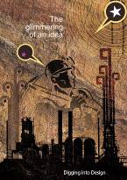

Composition of Contents
Works of Art

Slide 25
Immersion for VR Exhibition
Influencing Factors of Immersion in Virtual Reality Display
Division | Experience and immersion factors
Display Performance | Contrast ratio, color recall, color depth, color temperature, Gamma curve, Luminance
Image Resolution | Difference in image resolution.
Image Size | Difference in image size when using HMD device.
Exhibition layout | Shading and shadow effects

Slide 26
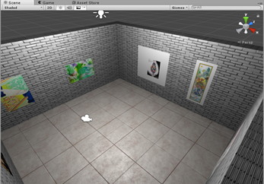
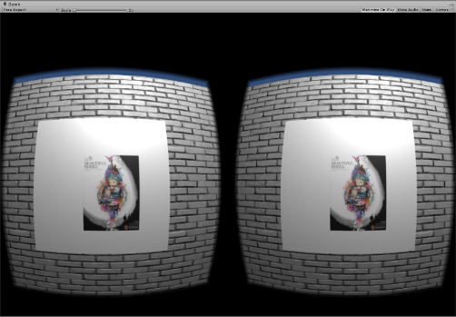

Slide 27
Conclusion
It breaks through the limitations of time and space. With Google Cardboard and smart phones, allows people who are passionate about art appreciation to visit art exhibitions anytime and anywhere. Users can observe the work from any angle
The organizer can update the display content at any time
This research analyzed the factors that affect user experience and immersion, explores the design of virtual reality art in the display environment of new media art, and can better reflect the combine of science and technology and art. Serving society in a wider range and based on existing conditions proposed ways to improve user experience and immersion
Notes:
借助虚拟现实技术，设计师可以按照自己的创意去搭建虚拟展示空间，用户可以以任意角度观察作品，主办方没有时空限制，可以随时更新展示内容，现在，智能手机已经普及并变成我们的日常生活必需品，通过智能手机可以很便捷的使用各种应用，利用Google Cardboard和智能手机，可以让热衷于艺术品鉴赏的人随时随地的参观艺术展，本研究分析了影响用户体验感和沉浸感的因素，探索新媒体艺术中虚拟现实艺术对展示活动中展示环境的设计，能更好的体现科学技术和艺术的完美结合。并根据现有条件提出了提高用户体验感和沉浸感的方法。

Slide 28
AR 3D Coloring game
This AR game enable a planar picture stand vividly revealed on the paper through a simple and portable mobile terminal scan. Multiple forms of interaction also stimulate the interest of learners and enable them to interact with 3D “buddies” and understand the world in the process
Break through the limitations of paper books, promote the acquisition and absorption of knowledge, improve the interactive effect of teaching, and fit in with the concept of entertaining, improving the students' ability to operate, identify and identify colors
Notes:
本章从增强现实应用的特点、产品设计与实现技术等方面做了较为详细的分析。 这两款AR游戏使得用户通过简单便携的移动终端扫描即可将平面化的图片“跃然纸上”，多种互动形式也激发了学习者的兴趣，使其在与立体化“伙伴”交流互动中学习知识，认识世界。突破纸质书的局限性，促进知识的获取和吸收，提高教学互动效果，与寓教于乐的理念相契合，提高学生的动手能力，认物和辨识颜色的能力。

Slide 29
Game Design
Coloring AR products are a few successful products in the current AR market. They have the following characteristics: high interactivity and entertainment; can be used independently or as part of the system, less investment compared to traditional games; collaboration between different domains is required, and UV map matching requires a higher level of computation
The color rendering has two ways:
Real-time rendering model texture content
Only rendering the model texture once receive instructions
Notes:
AR技术是将虚拟的形象和现实结合起来，互动应该是AR的主要侧重点，但实际上由于智能眼镜没有正式的上市，AR技术仍然停留在移动设备的屏幕上，这样造成了很多AR技术很多是作为一种噱头，目前AR应用还是以接受式视觉体验为主，涂色类AR产品是当前AR市场上少数的成功的产品，其有以下特点：娱乐互动性高；可独立应用也可作为系统的一部分，相对传统游戏投入较少；不同领域之间需要协作，贴图UV匹配计算要求较高。涂色类AR 的两种表现方式：1，实时渲染模型贴图内容；2， 只指定一次模型贴图而不实时地渲染内容

Slide 30
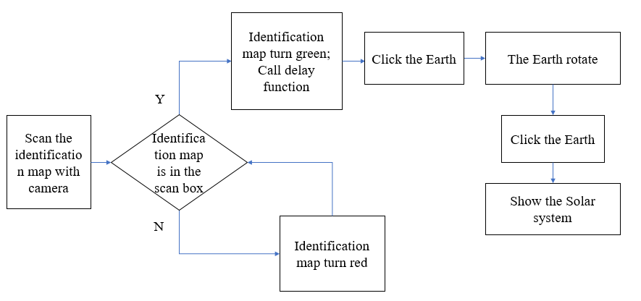
Gameplay

Slide 31
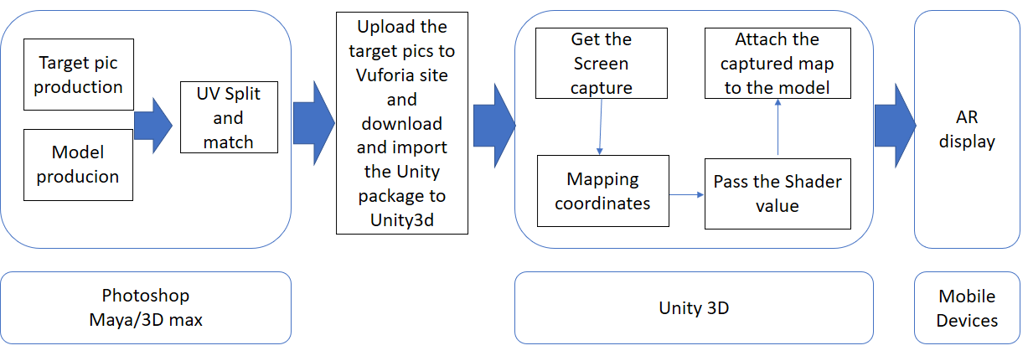
Implementation

Slide 32
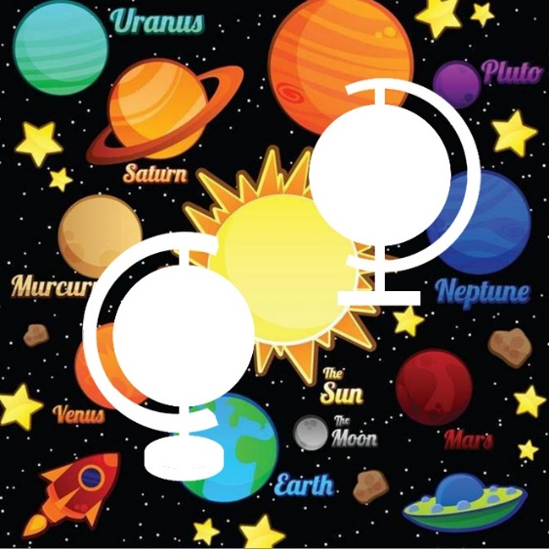

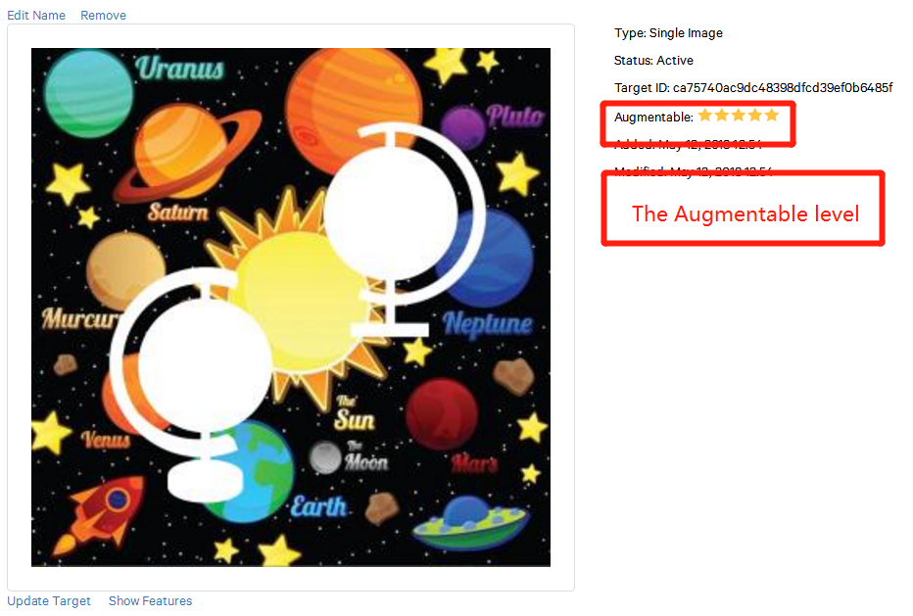
Identification pictures and Vuforia configuration
The picture for register The picture for identification
Vuforia configuration

Slide 33
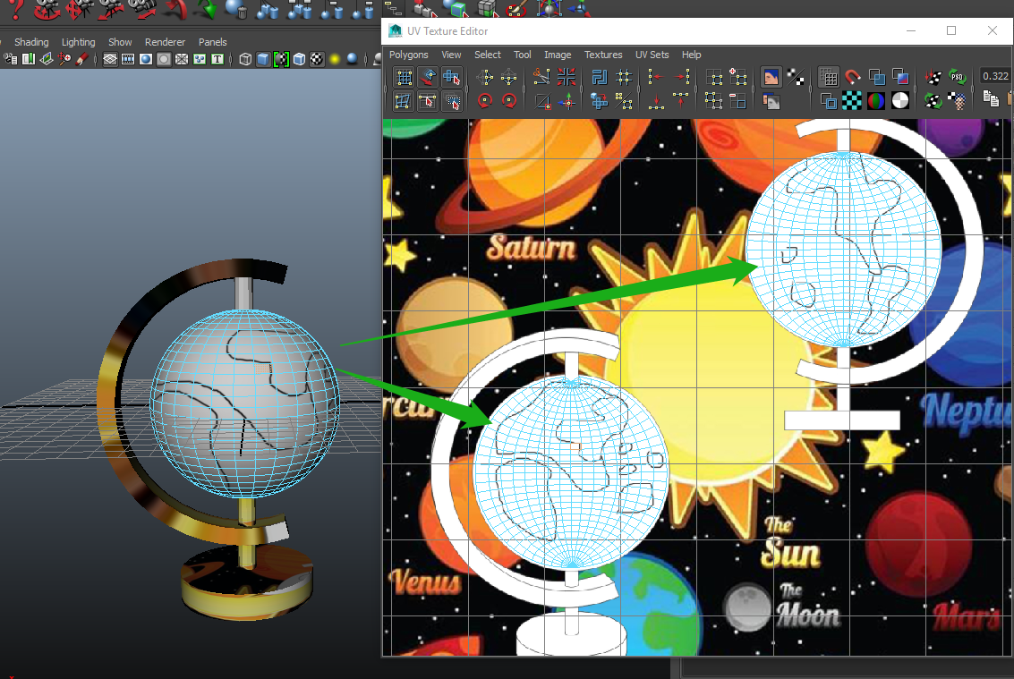
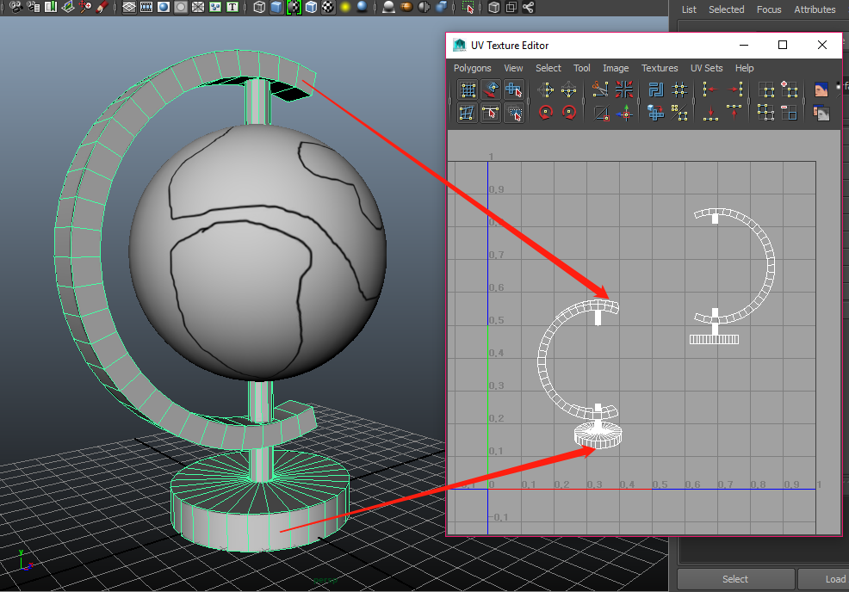
UV matching
UV matching of the tellurion earth model
UV matching of the tellurion frame

Slide 34
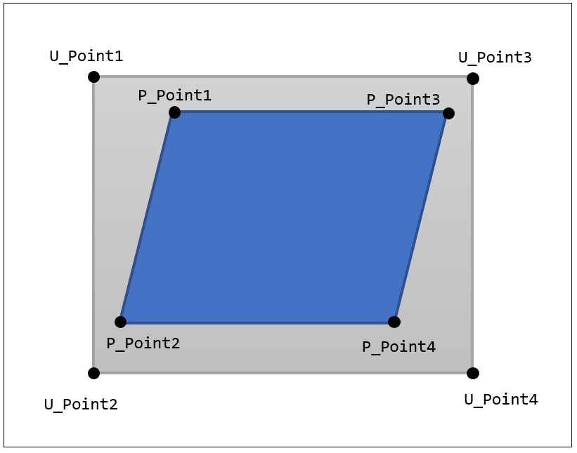
Texture coordinate calculation

Slide 35
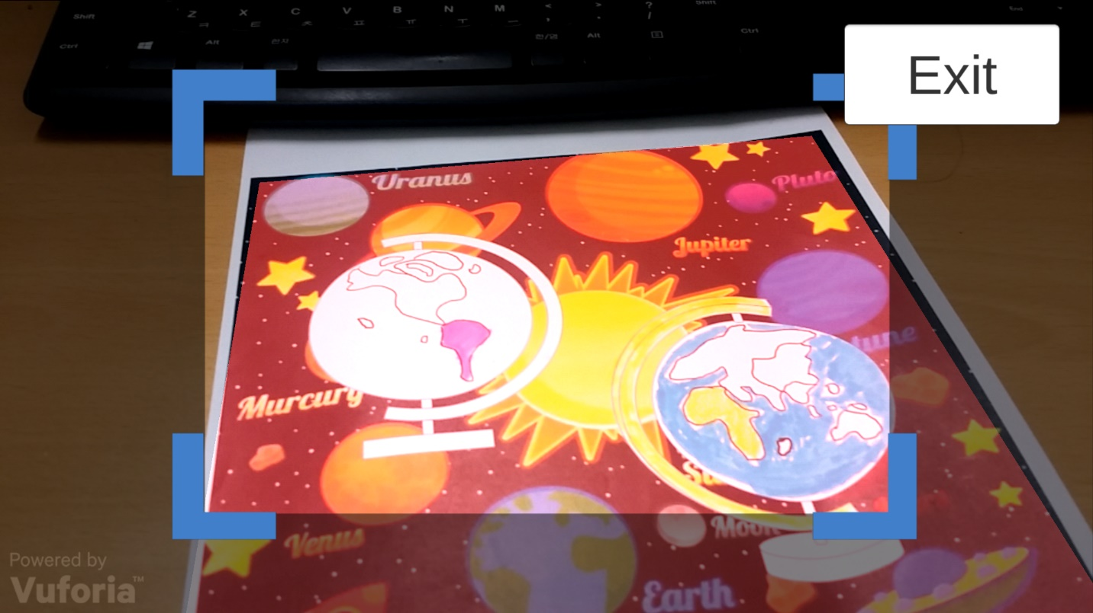
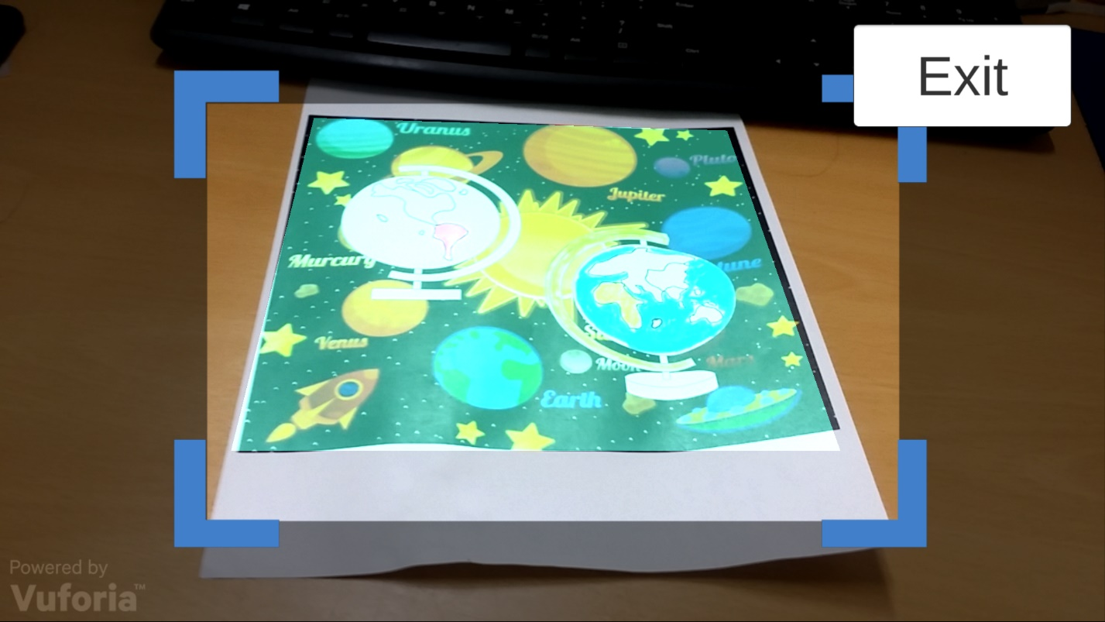
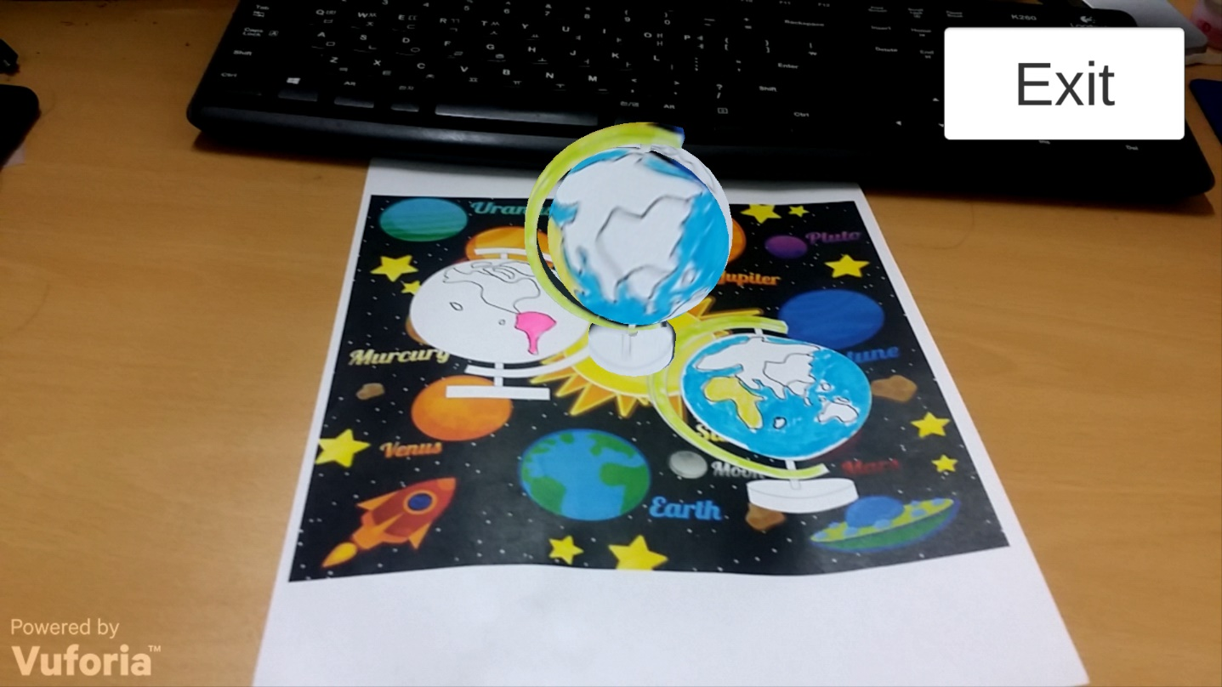
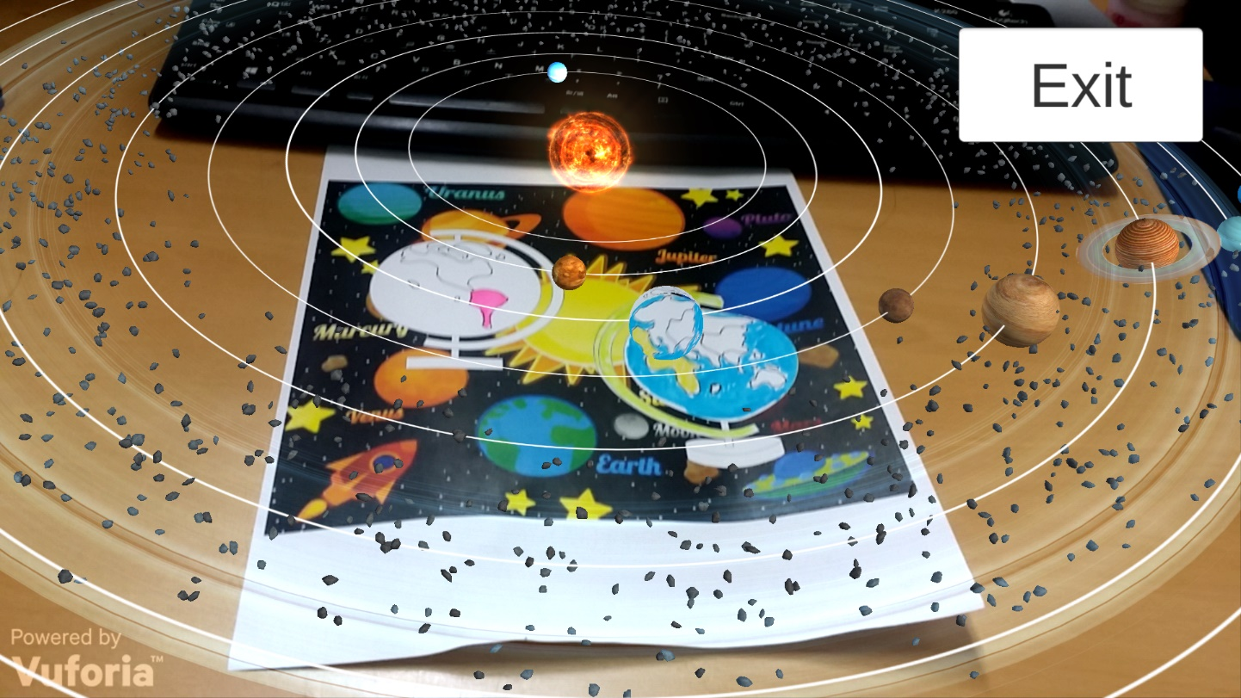

Slide 36
Conclusion
In Color the Earth application, young children improve their hands-on ability and understanding of colors through hand-painted colors, and more importantly, through the combination of educational content, young children have a preliminary understanding of the movement of the earth and celestial bodies and stimulate exploration interest
Notes:
在Color the Earth 应用中，幼儿通过手绘颜色，提高了动手能力和对颜色的认识，更重要的是，通过和教育内容的结合，使幼儿对地球和天体运动有了初步的认识，激发探索的兴趣

Slide 37
MR Chemistry Lab
Chemistry Lab MR is an educational experience that can virtually simulate lab procedures and important lab safety measures. The user is immediately immersed inside a Virtual Reality laboratory and can begin walking around using the Oculus HMD to interact with the environment. There are lab procedures and safety guides spread across the tables, and a great deal of lab equipment that can be picked up, placed, thrown, or actually used in real lab procedures
Through virtual experiment, students can perform simulation experiments in an environment closest to real, familiarize with the experimental process, observe and record experimental phenomena, save reagents, reduce danger, and achieve the goal of learning at anytime and anywhere
Notes:
通过虚拟的化学实验装备，学生既可以在没有违和感的环境下进行模拟实验，熟悉实验流程，观察和记录实验现象，节约试剂，减少危险，达到随时学习的目的

Slide 38
Experiment 1 : Magnesium ribbon combustion
Through this simple experiment, observe that a substance can generate other substances through chemical experiments.
2Mg + O2——ignite——2MgO
Mg + 2CH3COOH ——(CH3COO)2Mg + H2 (↑)
2CH3COOH + MgO=(CH3COO)2Mg + H2O
Eq (1) Magnesium is ignited under oxygen and burned generate magnesium oxide
Eq (2) Magnesium Rod produces Magnesium acetate and Hydrogen in acetic acid solution
Eq (3) Magnesium oxide produces magnesium acetate and H2O in acetic acid solution

Slide 39
The experimental phenomenon:
Intense burning, emitting dazzling light, taking a lot of white smoke, generate white solids. The effect of the dazzling white light emitted when the magnesium bar burned was achieved by a particle system. The burned magnesium bar was placed in a beaker containing acetic acid. The magnesium bar was gradually dissolved without bubbles; the unburnt magnesium bar was put in the same package. In beakers with acetic acid, magnesium strips were observed to gradually dissolve, and bubbles were generated in the beaker

Slide 40
Game Design
Leap Motion
Oculus HMD

Slide 41
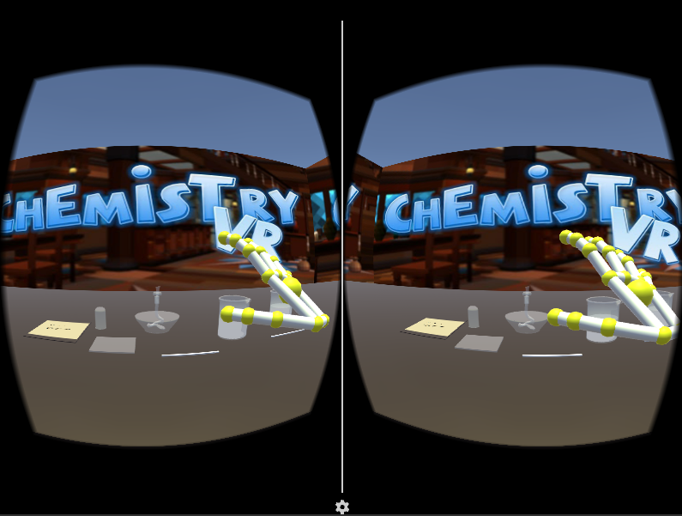
Leap Motion

Slide 42
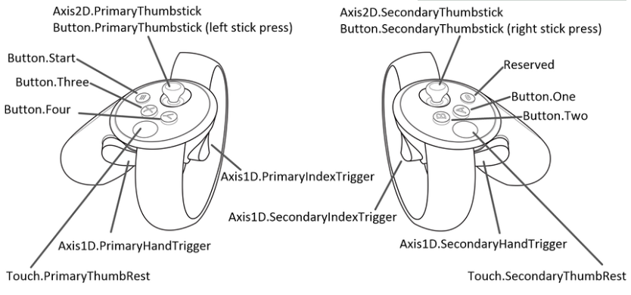
Oculus HMD

Slide 43
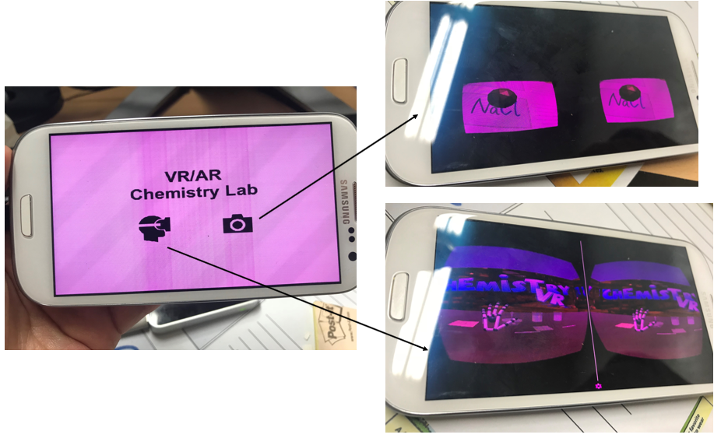

Slide 44
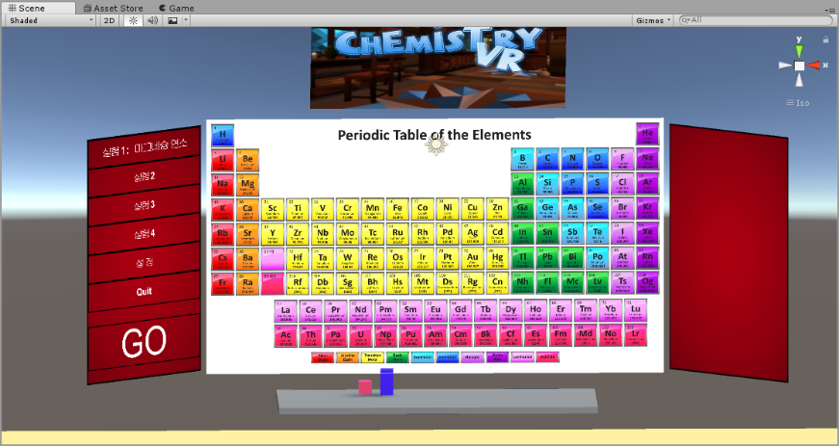
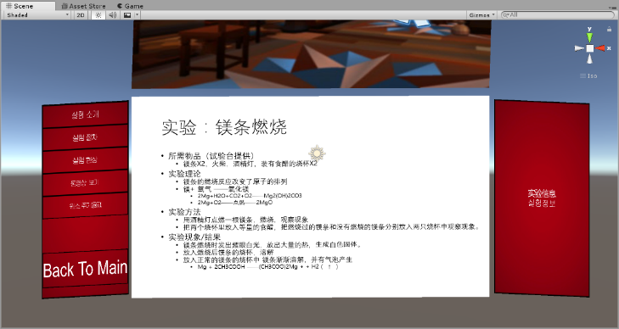
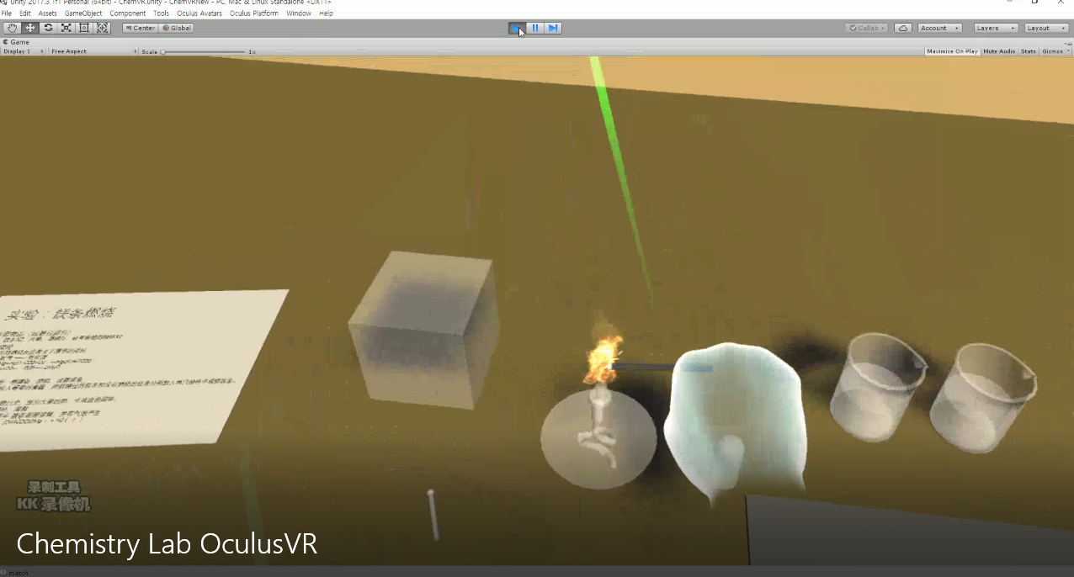
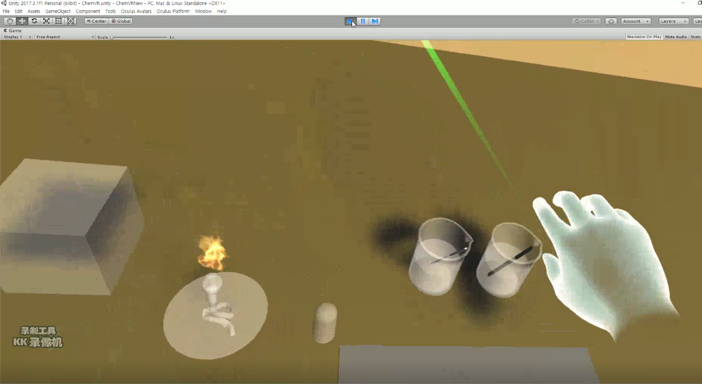

Slide 45
Evaluation
Evaluation system
Alvaro, Chief Research Institute in Non-profit Education Research and Development Institution and Babette, Researcher in Children and Family Member Center tease the document literature concerning gamification learning environment evaluation, concluding that the evaluation on the progressive program of digital gamification learning environment includes the following five procedures
Another similar case is 80days digital education game project group’s evaluation on education game. The evaluation process employs questionnaire survey method, expert examination method, experimentation method (users have to accept pre-test and after-test before learning), interview survey method, quantitative evaluation method and qualitative evaluation method
Referring to the characteristics of the game produced in this thesis, the evaluation procedure mainly uses comparative method, questionnaire survey method, interview method and gauge measurement method

Slide 46
Five Steps for Digital Gamification Learning Environment Evaluation
Procedures | Specific description
Step One | To acquire software by purchasing or obtaining demo and account and win evaluation permit
Step Two | To satisfy software operation hardware condition, clarify education purpose and target users, help realize learning goal and establish non-gamification learning environment
Step Three | To analyze the means of software evaluation in other organizations for reference
Step Four | To invite target users to try the software and conduct questionnaire and interview with them after the completion of experience
Step Five | To conduct further analysis with evaluation gauge

Slide 47
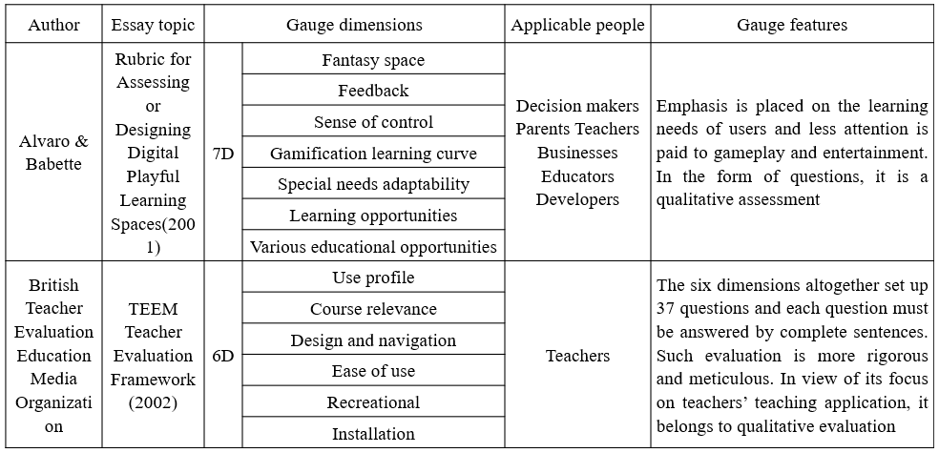
Educational Game Evaluation Gauges

Slide 48
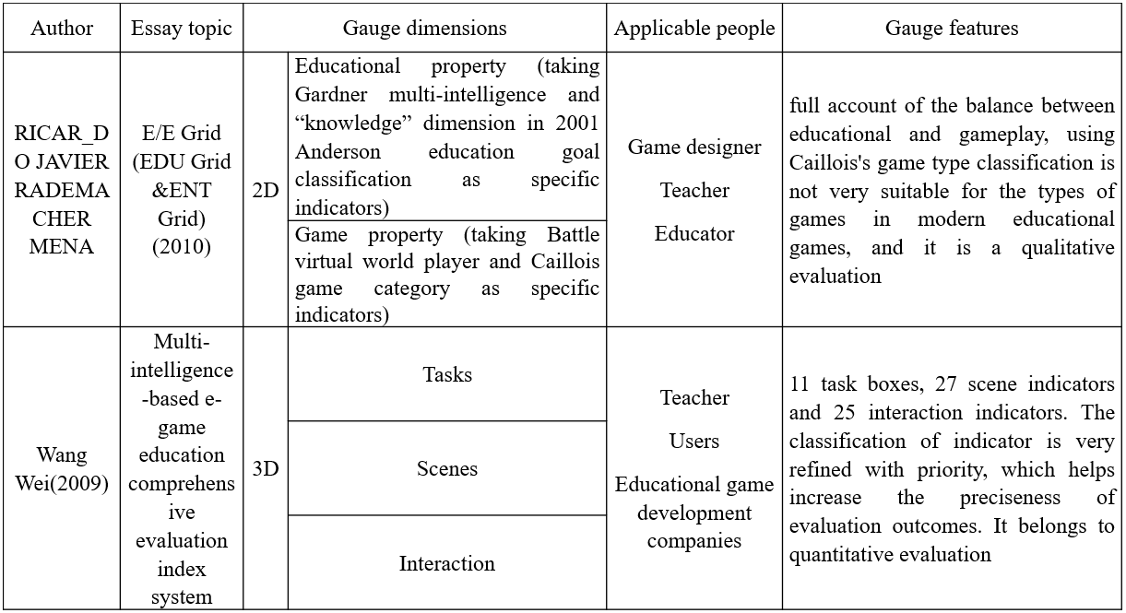

Slide 49
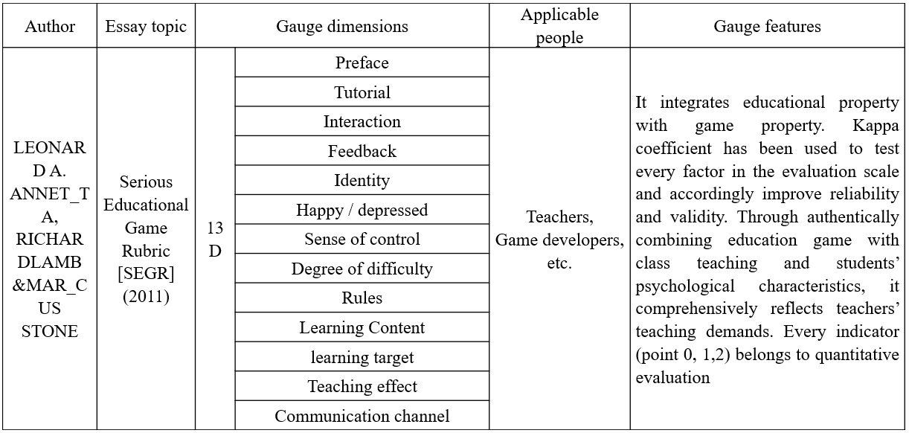

Slide 50
Gauge Dimension Design of Evaluation System in the Research
Gauge dimensions | Evaluation method
 | VR Art Exhibition | 3D Coloring Game | MR Chemistry Lab
Hardware Equipment | Record | Record | Record
Immersive | Interview | Interview | Interview
Educational effects | Interview | Questionnaire | Questionnaire
Interaction and of control Sense | Interview | Interview | Interview
Degree of Difficulty | Interview | Questionnaire | Questionnaire

Slide 51
Education Purposes and Target Objects of Each Game in the Application
Game Project | Target Object | Education Degree | Educational Goals (Effects)
AR 3D Coloring Game | 6 years old | Pre-school | To recognize the Earth and solar system and cultivate children’s color identification ability and operability
VR Art Exhibition | 20 years old | College | To appreciate art works
MR Chemistry Lab | 20 years old | College | To learn chemical experiments, familiar with experimental procedures and observe experimental phenomena

Slide 52
Evaluations for the 3 cases
Game | AR 3D coloring game |  | VR art Exhibition |  | MR Chemistry Lab
Group | Experimental Group | Comparative Group Normal | Experimental Group | Comparative Group Normal | Leap Motion Experimental Group | Oculus HMD Experimental Group | Comparative Group
Number | 15 | 15 | 15 | 15 | 15 | 15 | 15
Total | 45 |  | 30 |  | 45

Slide 53
VR Art Exhibition Evaluation
Experimental Objects
The evaluation chooses 30 college students, including 15 male college students and 15 female college students, and two teachers from the Arts Department
Research Design
Users in the experimental group utilize VR equipment in art exhibition appreciation, while experimental objects in the comparative group go to the real art exhibition scene to appreciate art works and later give evaluation
Experimental Results

Slide 54
Experimental Results
Gauge dimensions | Evaluation method | Evaluation result
 |  | Experimental group | Control group
Hardware equipment | Record | mobile terminal equipment (Android) | none
Immersive | Interview | relatively authentic | authentic
Educational effect | Questionnaire | repeated appreciation at any time and space | limit in time and space
Interaction & Sense of control | Interview | easy | none
Degree of difficulty | Questionnaire | simple | Difficulty in implementation
Notes:
结果表明，实际去画展现场的对象很享受观赏过程，但是现场人多，而且需要考虑交通和营业时间，而且买一次票只能看一次。 而利用虚拟现实的对象则反映，随时随地地欣赏画展，很便利，交互方式也很自然，几乎可以获得和真实的现场相同的体验， 但是作品的会出现一定程度的变型，这也是影响用户沉浸感的一个因素，以后也会找到解决途径加以改进。

Slide 55
AR 3D Coloring Game Evaluation
Experimental Subjects
30 students in a kindergarten are divided into two groups, with 15 members in the experimental group and 15 members in the comparative group. Moreover, teachers of children are also included in the research. Prior to the experiment, the researcher should guarantee that all experimental objects could familiarize with the most fundamental operation means of phones, such as button clicking
Experimental Design
Children in the experiment al group know Earth by AR game, and know the appearance of Earth and the profile of continents and oceans by filling colors in pictures via the phone screen. Simultaneously, children in the comparative group learn the profile of Earth and continents with traditional teaching method which combines graphic pictures and language instruction

Slide 56
Experimental Results
Gauge Dimensions | Evaluation method | Evaluation Results
 |  | Experimental Group | Comparative Group
Interesting | Interview | Vivid and Interesting | Dull and Boring
Hardware equipment | Record | Requirements for the game: Android phone, printed identification map Required hardware is readily available and portable | graphic picture display; teacher instruction
Educational effect | Interview | experimental subjects have preliminary recognition and deep impressions about Earth, continents and oceans | experimental subjects have preliminary recognition about the tellurion, but have superficial impression on it because of the shortage of practical participation
Interaction & Sense of control | Interview | simple operation mode; precise control by clicking | none
Degree of difficulty | Interview | Simple | Simple
Notes:
结果表明，在硬件设备方面，实验组在硬件设备上要求较高。运用了AR 技术的实验组在趣味性和教育效果方面明显优于对照组的传统教学方式，在交互方面，使实验对象直接参与互动，加深印象，对照组的实施更加简单由于幼儿园的孩子尚且年幼，不能表达自己的态度，为了更深入地了解这个实验，研究采访了这个班的英语老师。老师的意见总结如下：“这种学习方式将触觉，视觉结合在一起，并且学生可以发挥想象力用画笔表达自己的想法，更容易激发孩子学习的兴趣和探索的热情。

Slide 57
MR Chemistry Lab Evaluation
Experimental Objects
45 students from the Chemistry Department of certain university are chosen to be experimental objects. The evaluation has two experimental groups and one comparative group, among which the Leap Motion experimental group has 15 objects, the Oculus HMD experimental group has 15 objects and the comparative group has 15 objects in different genders. Two chemical teachers participate in the evaluation. Besides, all experimental objects should familiarize with equipment and operation mode before evaluation
Research Design
Users in the experimental group utilize VR equipment in art exhibition appreciation, while experimental objects in the comparative group go to the real art exhibition scene to appreciate art works and later give evaluation

Slide 58
Experimental Results
Gauge Dimensions | Evaluation Method | Evaluation result
 |  | Leap Motion Experimental group | Oculus HMD experimental group | Control group
Hardware equipment | Record | Leap Motion Andriod phone | expensive, poor mobility | none
Immersive | Interview | Relatively strong | Strong | To operate experiment after watching teachers’ demonstration
Educational effect | Questionnaire | To repeatedly exercise the flow and observe phenomena | To repeatedly exercise flow, observe phenomena and deepen impression | Unimpressive
Interaction & Sense of Control | Interview | Poor precision and control sense | good interactive precision and interactive control; dizziness after long-term wearing | None
Degree of Difficulty | Questionnaire | Difficult | Relatively difficult | Simple
Notes:
评价结束后，对实验对象进行了访谈，结果表明，请实验对象谈论自己对学习工具的感受。首先，学生表示MR工具可以较好地帮助记忆原子的结构。在传统课堂上，仅通过老师的简单指导，对抽象的原子结构并不能有很直观的印象，学生对于知识的理解度和记忆持久度较低。但基于MR的软件教学可调动学生积极性，促使其注意力更加集中。在直观地看到仿真模型并与其交互后，对所学知识的印象也更加深刻。其次，与传统ppt或者flash课件和其他3D建模软件相比，MR工具能提高学生对于实验探究的操作能力，最重要的是，不用担心试剂和实验器材的安全性和用量过度问题，在这个前提下，反复的熟悉实验的流程，对以后真正的实验过程是很有帮助的。相比于键盘鼠标与计算机的操作，直接通过相对来说更加自然交互方式对程序性知识的识记效果更好。同时，学生也对这个工具提出了一些建议，例如他们希望物质的模拟现象能更加逼真。是否想要在未来学习中使用AR工具时，他们一致回答“想”，在沉浸感方面，两个实验组的表现比较接近由于Leap Motion是直接采用手势识别，因此更接近自然交互，但是就交互操作的精确度和难易度来说，Oculus HMD明显的优于Leap Motion，但是在教育效果这个评价量规上，实验组的教育效果明显优于对照组，也就是说运用混合现实技术，可以获得更好的教育效果

Slide 59
Conclusions
There are 3 educational application cases of virtual reality technology in the foregoing chapters. In view of disciplines including design basis, education, geology and preschool education, and the result of evaluation, if the virtual reality technology is applied in the school education, the previous investment of infrastructure may be huge.However, students can have better study experience and ideal educational outcomes can basically be achieved

Slide 60
The virtual reality hardware devices, such as OCULUS HMD, still have technical problems and there is no breakthrough. For example, vertigo can be easily caused by long term use and the hardware device of gesture recognition Leapmotion, which can interact more naturally, needs to be improved and elevated in terms of accuracy and sensibility, so as to provide sustained and lasting sense of immersion for students. Besides, according to evaluation results, we can see that, compared with virtual reality devices such as OCULUS HMD, there is no need to wear heavy headgear to enhance real environment. We do not need to place special locators or define specific activity range to capture the location of users. All we need is a tablet or a mobile phone with a camera, so that we can integrate and interact in the real environment with virtual objects
As a result, the learning environment with relatively low requirement for hardware is more easily realized at school. Although it can be realized technically, the way of its combination with specific educational content needs to be designed with more efforts and time
Notes:
前边章节中介绍的3个虚实混合现实教育应用案例，从学科上看，设计基础教育领域化学 地理 幼儿教育，通过评价的结果可以看出，虚拟现实技术环境如果投入到学校教育教学中，前期的设备投入将会比较大，但是给学生带来的学习体验较好，也基本可以达到很好的教育效果，
但是现在虚拟现实硬件设备如OCULUS HMD还存在瓶颈没有得到突破，比如长期佩戴使用容易引起眩晕症，又比如交互方式更接近自然交互的手势识别硬件设备Leapmotion 在精确度上和识别的敏感度上还需要改进和提升，才能为学生提供持久连续的沉浸感。另外 根据评价结果，我们还可以看出相对于使用OCULUS HMD 等虚拟现实设备，增强现实环境不需要佩戴沉重的头盔，不需要放置用来捕获用户空间位置的专用定位器和特定活动范围，仅仅需要平板或者手机（本身带摄像头）即可做到真实环境和虚拟对象的融合互动，因此对于硬件条件要求不高的学习环境更容易在学校落实，虽然技术的实现上很简单，但是如何和特定的教育内容的结合，需要前期多投入精力和时间在设计上

